Slide 2
Introducing LifeTrack
What is LifeTrack?
How it Works & Why it Helps
Ongoing Client Communication
Setting it Up
A Year in the Life of a LifeTrack Policyowner
Top Reasons to Sell John Hancock with LifeTrack

Slide 3
What is LifeTrack?
LifeTrack is a first-of-its kind policy management service from John Hancock that helps keep clients on track to meet their insurance goals.
LifeTrack is:
Dynamic – The LifeTrack Premium changes as policy experience changes
Optional – Owners may add or remove it from available products at any time
Free of charge
Available on Protection UL ‘15, Protection IUL ‘15, and Accumulation IUL ’15
An Easier Way to manage policies for you and your clients

Slide 4
How LifeTrack Works
On each billing date, a new LifeTrack Premium will be calculated that takes into account:
Current policy value
Current crediting rate (UL) or Client’s assumed index crediting rate (IUL)
Current Vitality Status
LifeTrack will calculate the premium that is projected to achieve the client’s objectives
(e.g. endow at life, $1M of policy value at age 65, etc.) based on the assumptions above

Slide 5
Why LifeTrack Helps
LifeTrack helps because things change
With traditional billing, it is the client’s responsibility to adjust planned premiums as things change over time. If this responsibility is overlooked, last-minute premium adjustments can be much more costly than timely ones
Consider a client who pays the billed premium in all years but 4 and 5:
YEAR | AGE | TRADITIONAL BILLING |  | LIFETRACK BILLING
 |  | WHAT THEY'RE BILLED | WHAT THEY PAY | WHAT THEY'RE BILLED | WHAT THEY PAY
1 | 45 | $5,000 | $5,000 | $5,000 | $5,000
2 | 46 | $5,000 | $5,000 | $5,000 | $5,000
3 | 47 | $5,000 | $5,000 | $5,000 | $5,000
4 | 48 | $5,000 | $0 | $5,000 | $0
5 | 49 | $5,000 | $0 | $5,404 | $0
6 | 50 | $5,000 | $5,000 | $5,904 | $5,904
YEARS LATER
44+ | 88+ | $5,000 | $91,314 | $5,904 | $5,904
Female 45, Best Class. Level-pay Protection IUL, $971k DB, solving to endow at age 121 at 6% ROR.
This is a supplemental illustration. Not all benefits and values are guaranteed. The assumptions on which the non-guaranteed elements are based are subject to change by the insurer. Actual results may be more or less favorable.

Slide 6
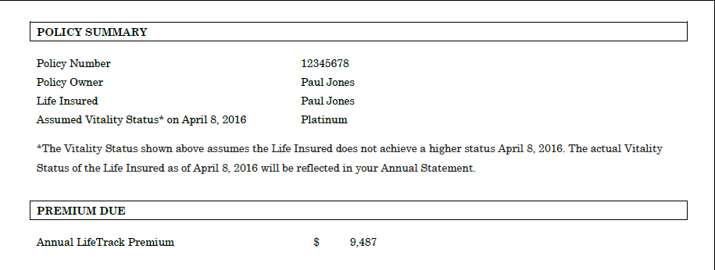
Ongoing Client Communication
LifeTrack Premium Notice (“The Bill”)
As with all UL policies, client can still pay any amount (within limits)
The Bill indicates the amount that is projected to keep them on track

Slide 7
Ongoing Client Communication
LifeTrack Premium Notice (“The Bill”)
As with all UL policies, client can still pay any amount (within limits)
The Bill indicates the amount that is projected to keep them on track
LifeTrack Annual Report (Sent with the Annual Statement)
Explains any changes in the last policy year that led to changes in the LifeTrack Premium
Shows owners of John Hancock with Vitality policies how much they saved by taking healthy steps throughout the year
LifeTrack Premium Update (Emailed to Vitality members only)
Shows clients how the John Hancock Vitality program is helping them save
Encourages them to reach the next Status before their bill date
LifeTrack Annual Report
LifeTrack Premium Update
LifeTrack Premium Notice
LifeTrack Annual Report
Sent with Annual Statement at policy anniversary
Email sent 60 days prior to anniversary
Bill sent 28 days prior to anniversary
Sent with Annual Statement at policy anniversary

Slide 8
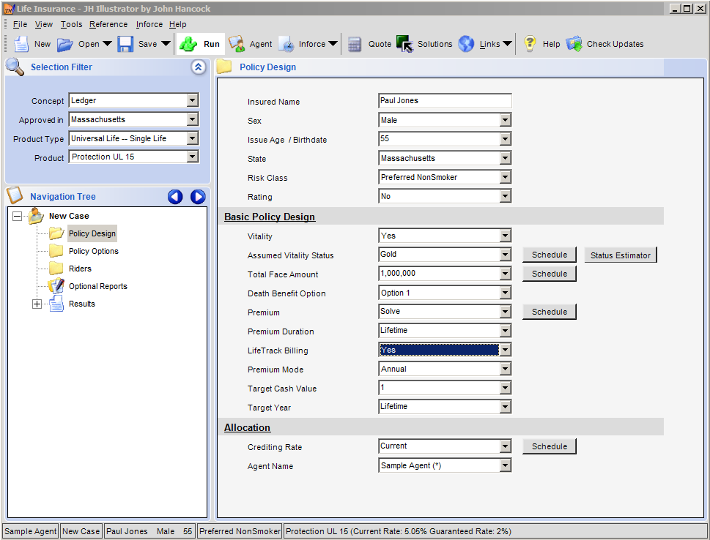
Setting it Up
Illustrating LifeTrack
LifeTrack Premium Update
LifeTrack Premium Notice
LifeTrack Annual Report
Policy Issue
First policy anniversary

Slide 9
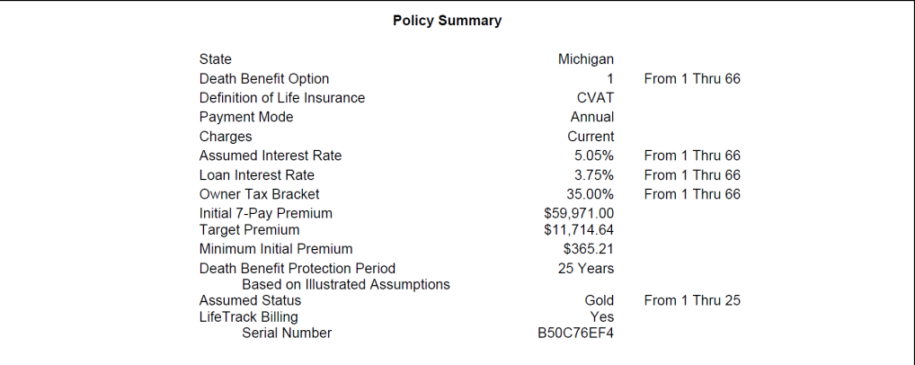
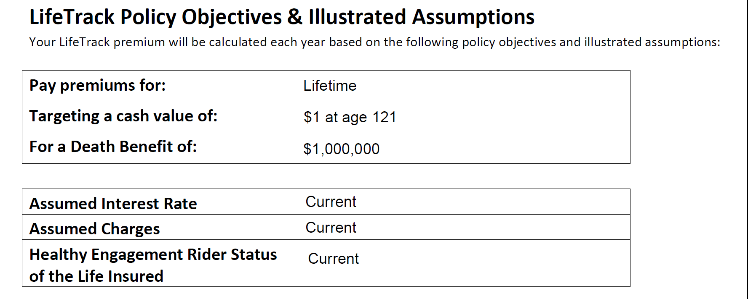
Setting it Up
LifeTrack Election Form
LifeTrack Premium Update
LifeTrack Premium Notice
LifeTrack Annual Report
Policy Issue
First policy anniversary
LifeTrack Election Form produced with illustration when “Yes” is chosen for LifeTrack
Every LifeTrack policy receives unique Serial Number, which stores the objectives of the client’s premium solve
Client reviews and signs to confirm their objectives

Slide 10
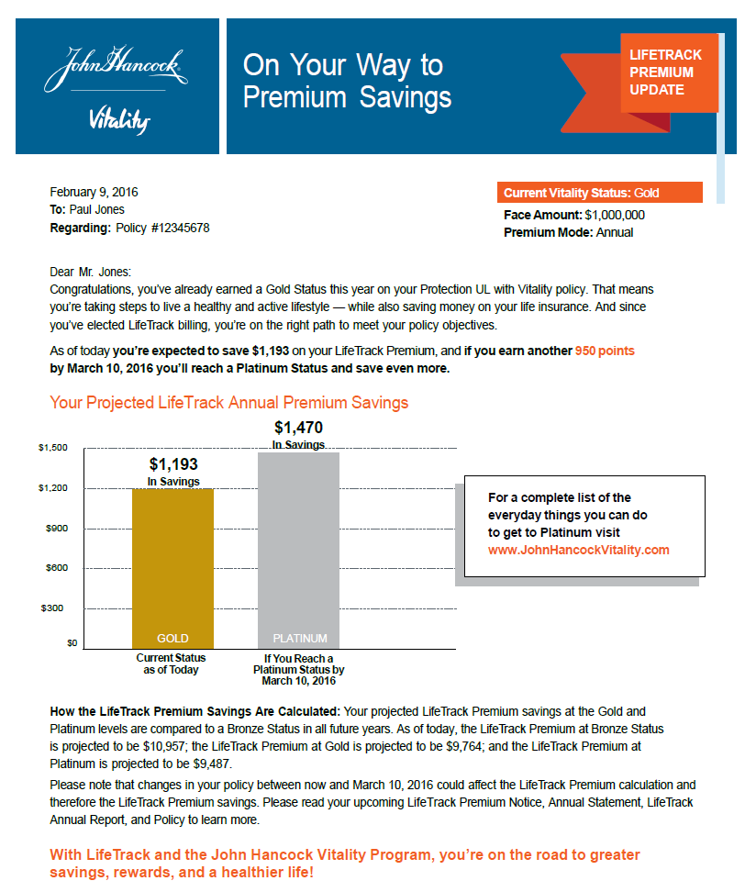
Approaching Year End – Last Chance to Save
LifeTrack Election Form
Policy Year 1
LifeTrack Premium Update
LifeTrack Premium Notice
LifeTrack Annual Report
Policy Issue
First policy anniversary
60 days before policy anniversary policy owners who are also Vitality members receive LifeTrack Premium Update via email
Shows how much they’ve saved so far, and how much more they can save by earning a higher Vitality Status
Insureds are encouraged to earn more Vitality points before their bill
Male 55, Preferred. Level-pay Protection UL solving for $1 at age 121. Not all benefits and values are guaranteed. The assumptions on which the non-guaranteed elements are based are subject to change by the insurer. Actual results may be more or less favorable.

Slide 11
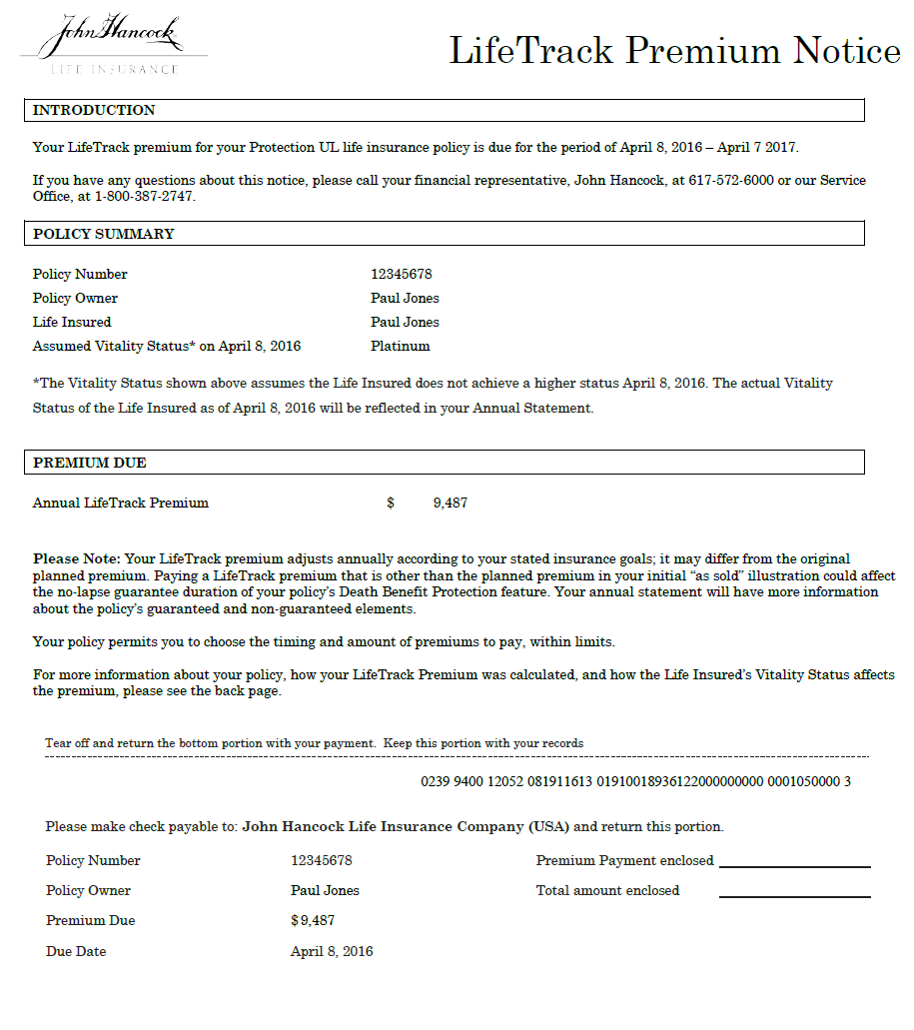
LifeTrack Billing is Smart Billing
LifeTrack Election Form
Policy Year 1
LifeTrack Premium Update
LifeTrack Premium Notice
LifeTrack Annual Report
Policy Issue
First policy anniversary
28 days before policy anniversary LifeTrack Premium Notice is sent
Front page includes the premium based on up-to-the-minute policy performance
Male 55, Preferred. Level-pay Protection UL solving for $1 at age 121. Not all benefits and values are guaranteed. The assumptions on which the non-guaranteed elements are based are subject to change by the insurer. Actual results may be more or less favorable.

Slide 12
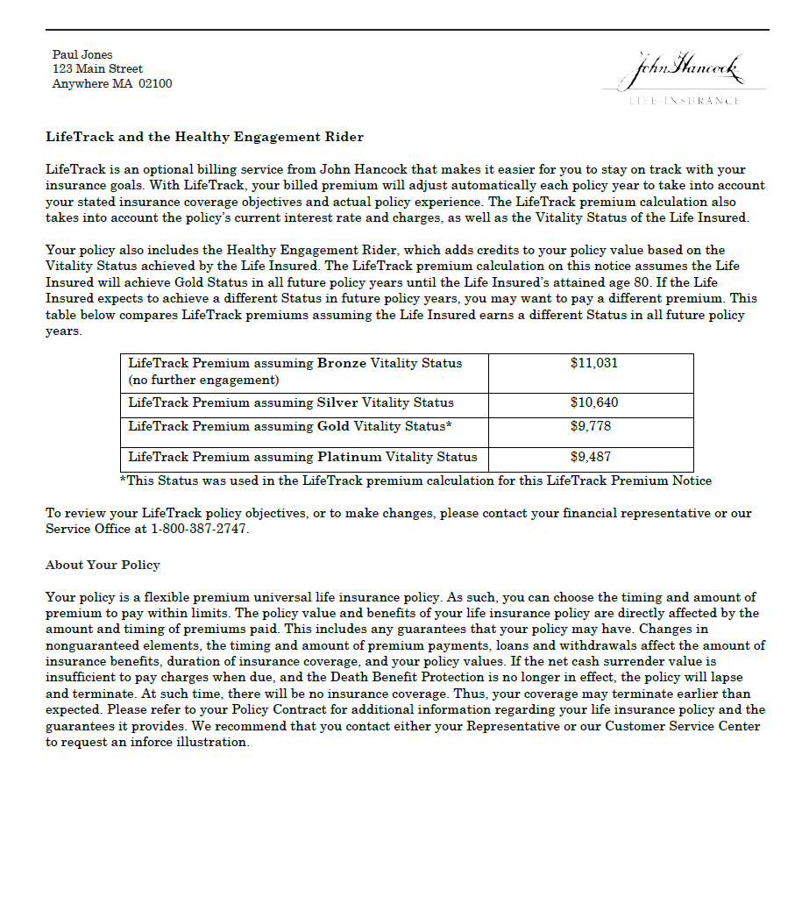
LifeTrack Billing is Smart Billing
LifeTrack Election Form
Policy Year 1
LifeTrack Premium Update
LifeTrack Premium Notice
LifeTrack Annual Report
Policy Issue
First policy anniversary
28 days before policy anniversary LifeTrack Premium Notice is sent
Front page includes the premium based on up-to-the-minute policy performance
And for policies with Vitality, the back page includes a premium calculation based on each of the four Status levels
Male 55, Preferred. Level-pay Protection UL solving for $1 at age 121. Not all benefits and values are guaranteed. The assumptions on which the non-guaranteed elements are based are subject to change by the insurer. Actual results may be more or less favorable.

Slide 13
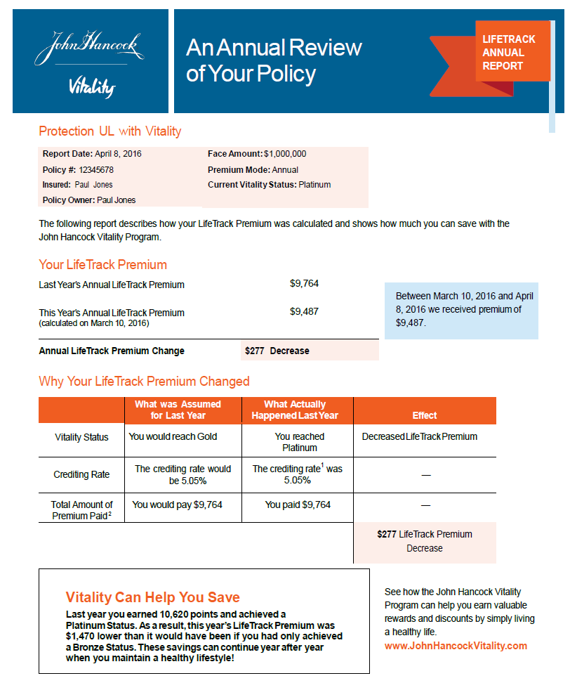
A Year in Review
LifeTrack Election Form
Policy Year 1
LifeTrack Premium Update
LifeTrack Premium Notice
LifeTrack Annual Report
Policy Issue
First policy anniversary
The LifeTrack Annual Report is sent along with the usual annual statement
Summarizes any changes to factors that affect policy performance (e.g., Vitality Status, crediting rate, premium payments)
And reminds clients with Vitality how much they have saved by taking healthy steps in their lives
Male 55, Preferred. Level-pay Protection UL solving for $1 at age 121. Not all benefits and values are guaranteed. The assumptions on which the non-guaranteed elements are based are subject to change by the insurer. Actual results may be more or less favorable.

Slide 14
Mr. Jones’ Journey Beyond Year 1
Policy issued assuming premiums & Gold Status in all years
Gold Status achieved
Platinum Status achieved
Unscheduled Lump Sum of $20,000 received
Male 55, Preferred. Level-pay Protection UL solving for $1 at age 121. Not all benefits and values are guaranteed. The assumptions on which the non-guaranteed elements are based are subject to change by the insurer. Actual results may be more or less favorable.
.

Slide 15
Top 5 Reasons to Sell John Hancock with LifeTrack
Dynamic premium notices adjust each year based on actual policy performance – unlike static notices that may bill an amount determined many years in the past
LifeTrack Premiums are calculated based on the client’s stated goals, so they are unique to them
Personalized communications ensure clients will always understand the amount to pay to keep pace with their insurance objectives
Extra motivation for John Hancock Vitality members to take a few more steps toward living a healthier life and earn more savings
Easier policy management and new opportunities to engage clients on an ongoing basis

Slide 16
Disclosures
Insurance policies and/or associated riders and features may not be available in all states. Some riders may have additional fees and expenses associated with them.
Paying a LifeTrack premium that is other than the planned premium on the initial ‘as sold’ illustration could reduce the duration of a policy’s Death Benefit Protection feature or No Lapse Guarantee.
Vitality is the provider of the John Hancock Vitality Program in connection with policies issued by John Hancock.
Insurance products are issued by John Hancock Life Insurance Company (U.S.A.), Boston, MA 02117 (not licensed in New York) and John Hancock Life Insurance Company of New York, Valhalla, NY 10595.
MLINY071515093

